Slide 1
Class work Nucleotide sequence database: DNA and RNA
23/05/2024
Phuc-Loi Luu, PhD
Luu.p.loi@googlemail.com

Slide 2
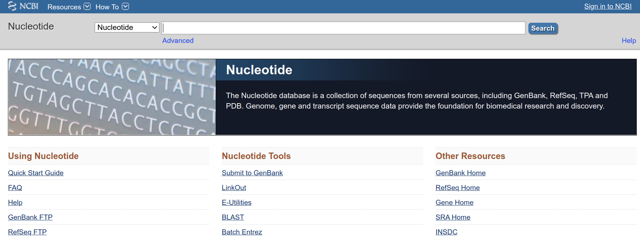
https://www.ncbi.nlm.nih.gov/nucleotide/
Where possible, the sequences are annotated so that you can find the strings of sequences that may be functional.

Slide 3
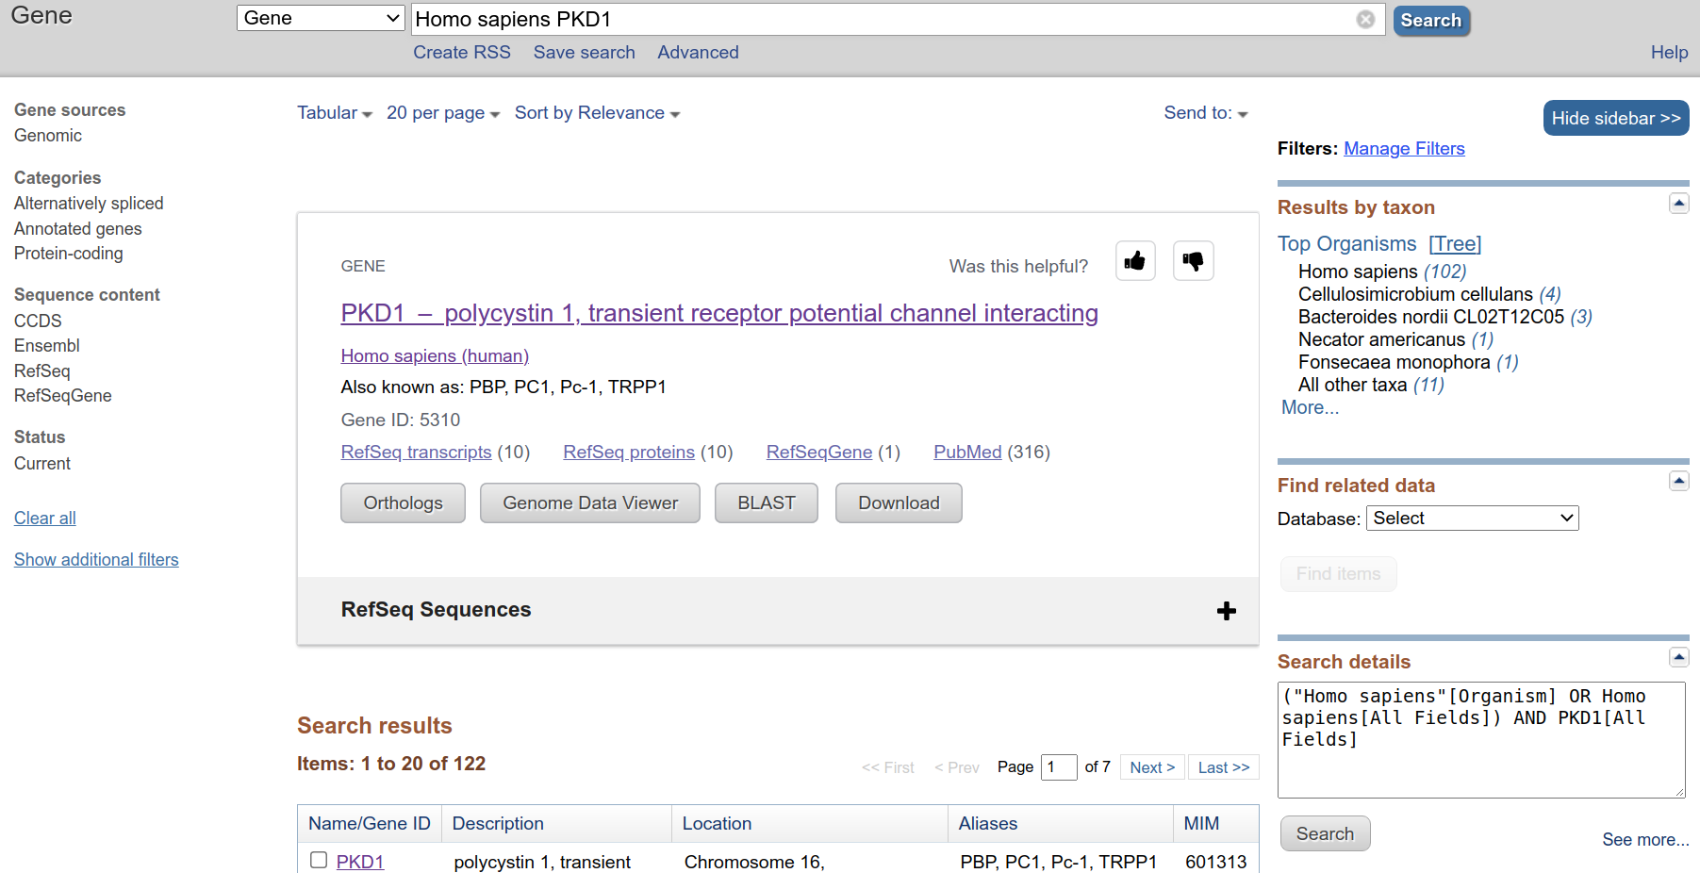
Example 5: Human PKD1
Search with Human PKD1 Gene.

Slide 4
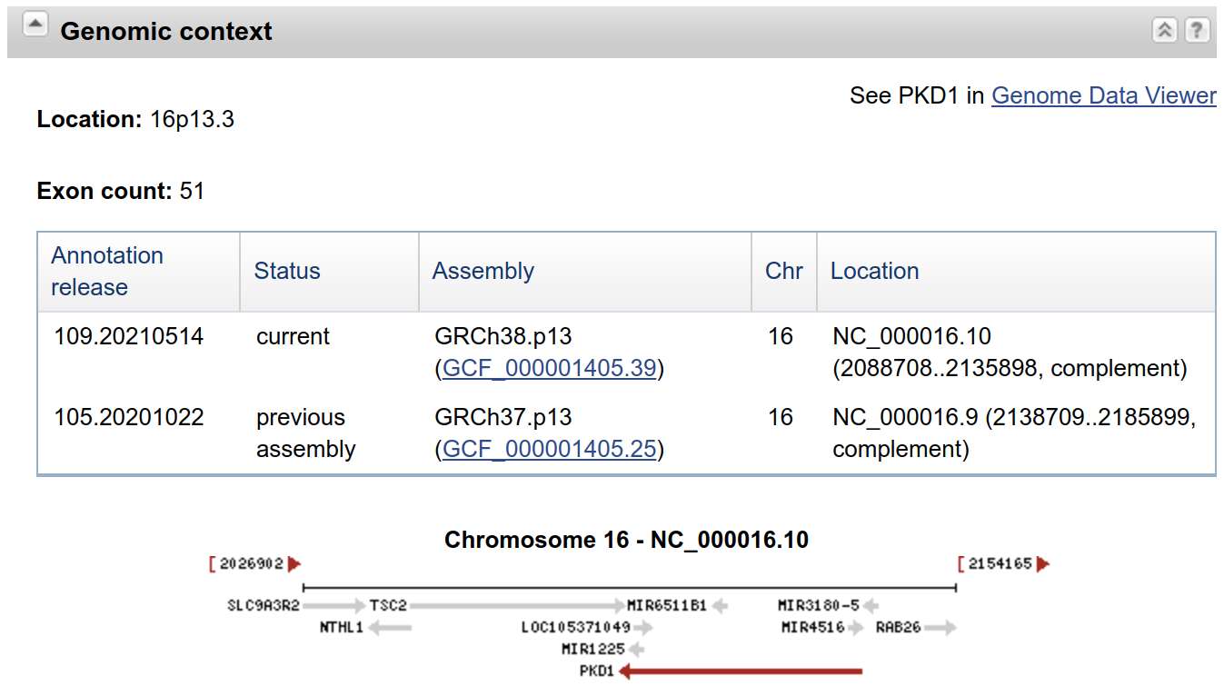
Example 5: Human PKD1
How many exons of Human PKD1?
https://www.ncbi.nlm.nih.gov/gene/5310

Slide 5
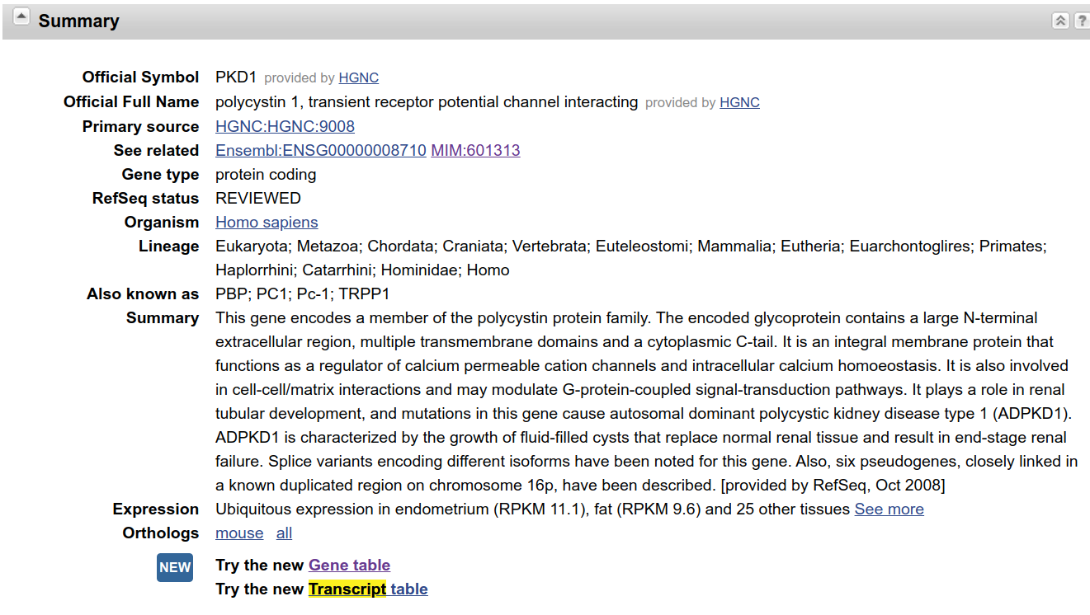
Example 5: Human PKD1
How many transcripts of Human PKD1?
https://www.ncbi.nlm.nih.gov/gene/5310

Slide 6
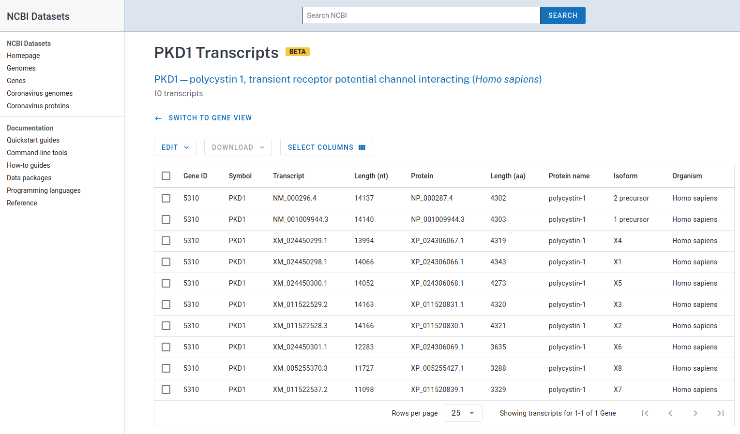
Example 5: Human PKD1
How many transcripts of Human PKD1?
https://www.ncbi.nlm.nih.gov/gene/5310

Slide 7
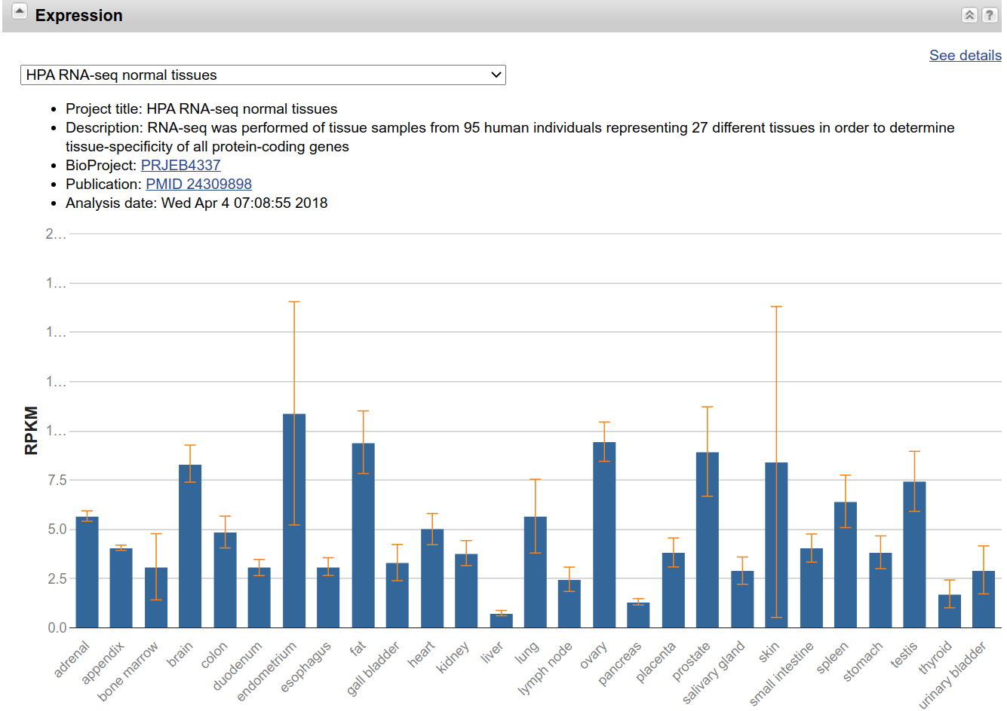
Example 5: Human PKD1
Is Human PKD1 expressed in all the tissues?
https://www.ncbi.nlm.nih.gov/gene/5310

Slide 8
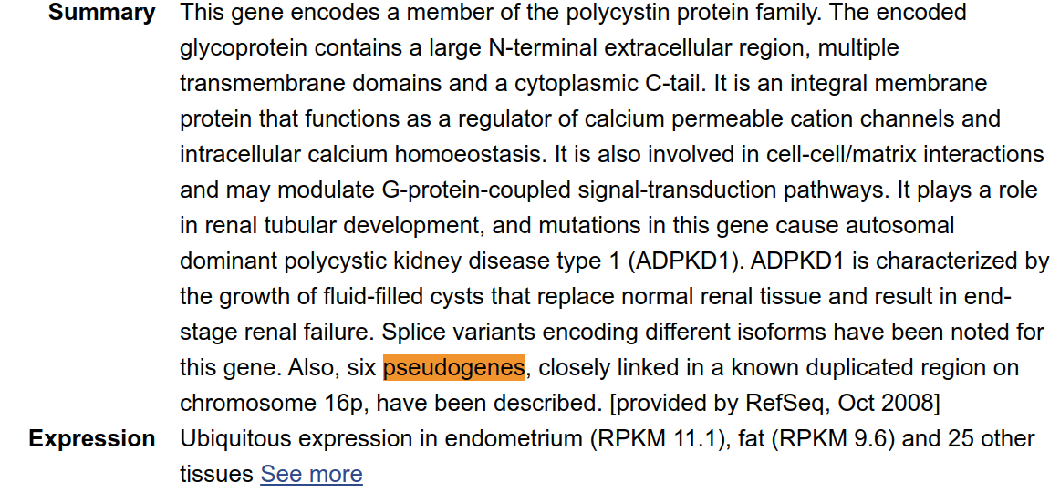
Example 5: Human PKD1
How many pseudogenes of Human PKD1?
https://www.ncbi.nlm.nih.gov/gene/5310

Slide 9
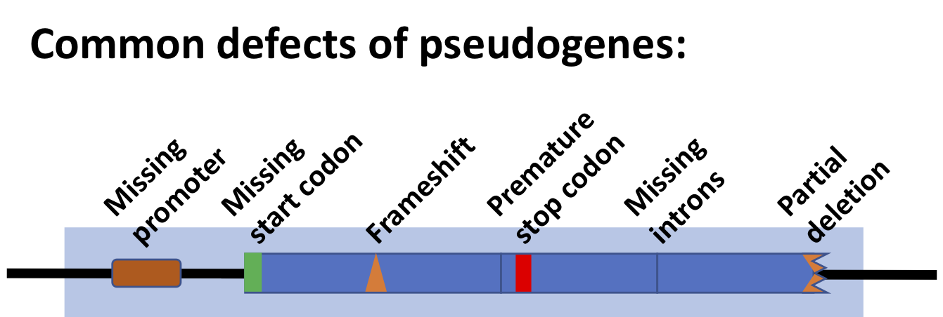
Example 5: Human PKD1
What is Pseudogenes?
Pseudogenes are nonfunctional segments of DNA that resemble functional genes.
Most arise as superfluous copies of functional genes, either directly by DNA duplication or indirectly by reverse transcription of an mRNA transcript.
Pseudogenes are usually identified when genome sequence analysis finds gene-like sequences that lack regulatory sequences needed for transcription or translation, or whose coding sequences are obviously defective due to frameshifts or premature stop codons.
https://en.wikipedia.org/wiki/Pseudogene

Slide 10
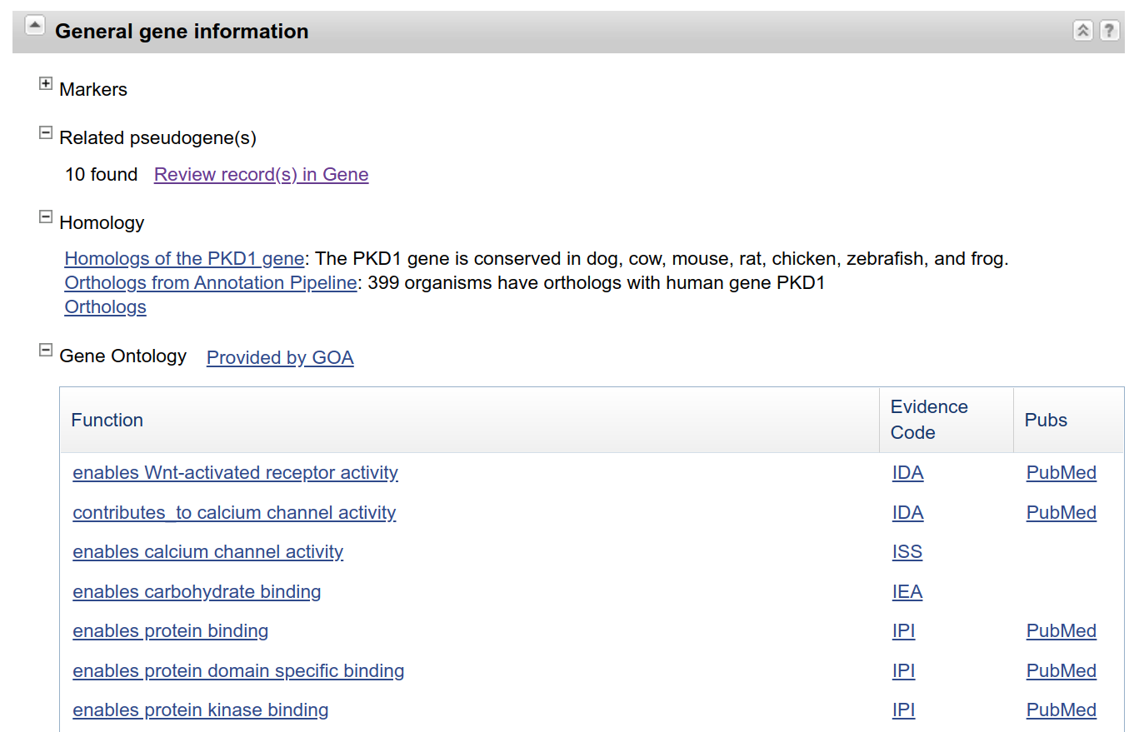
Example 5: Human PKD1
How many pseudogenes of Human PKD1?
https://www.ncbi.nlm.nih.gov/gene/5310

Slide 11
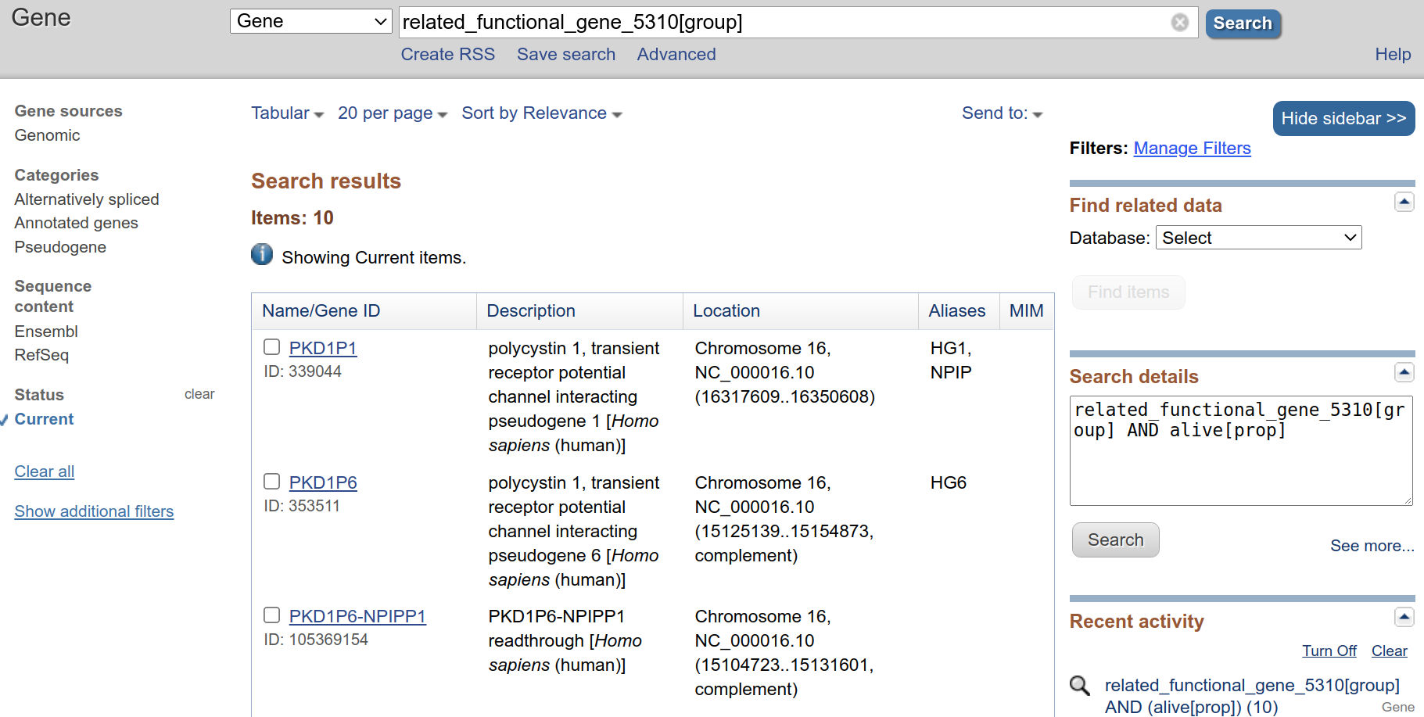
Example 5: Human PKD1
How many pseudogenes of Human PKD1?
https://www.ncbi.nlm.nih.gov/gene/?Term=related_functional_gene_5310%5Bgroup%5D

